Slide 1

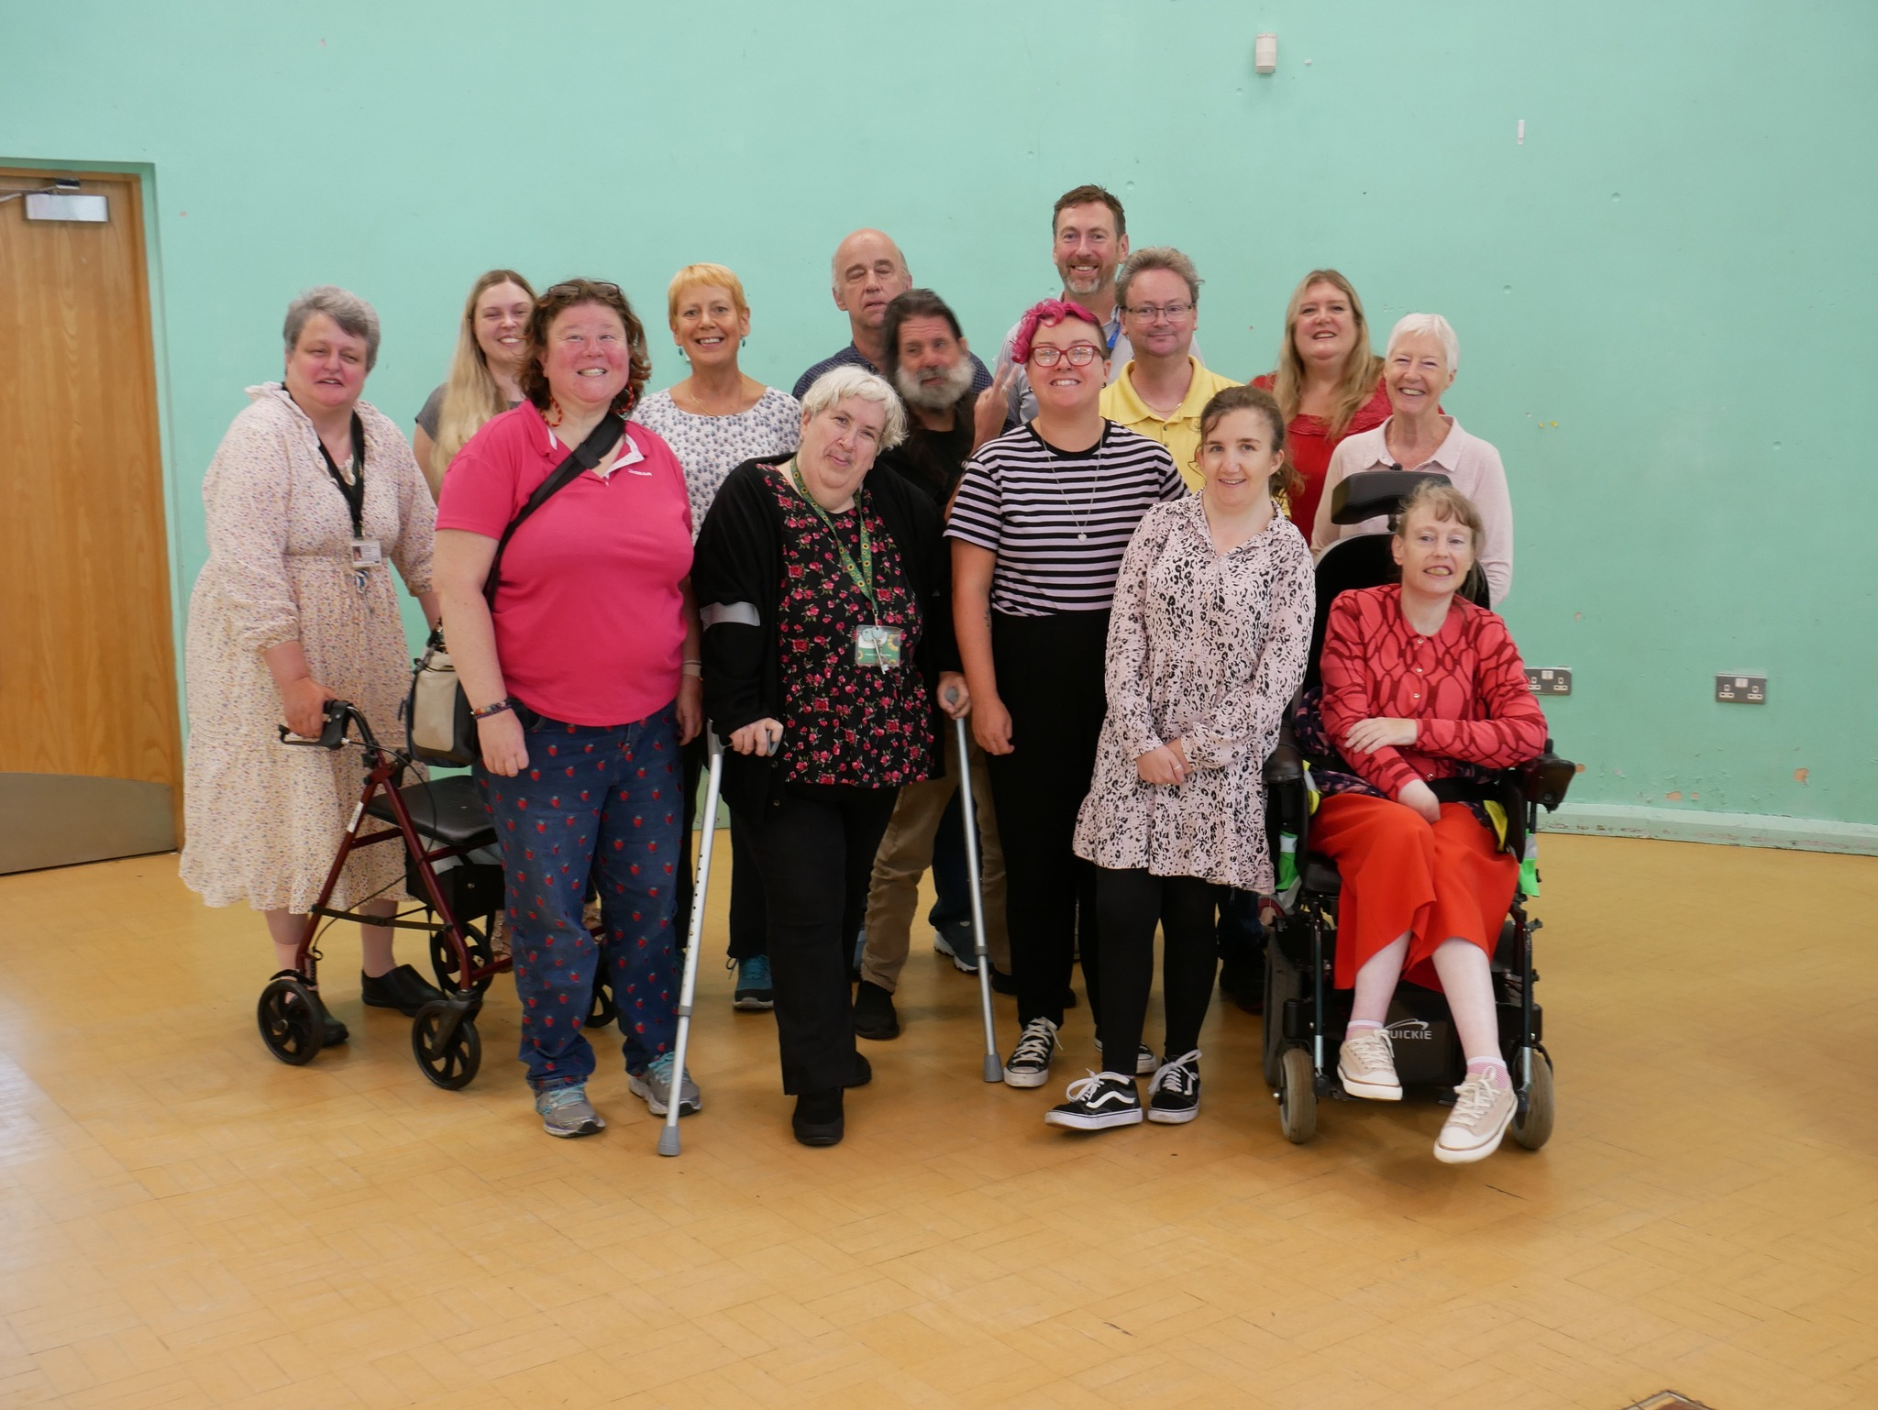

Slide 2
Who are Sheffield voices?
History
What are we about
Who, where, when
Other stuff we do

Slide 3
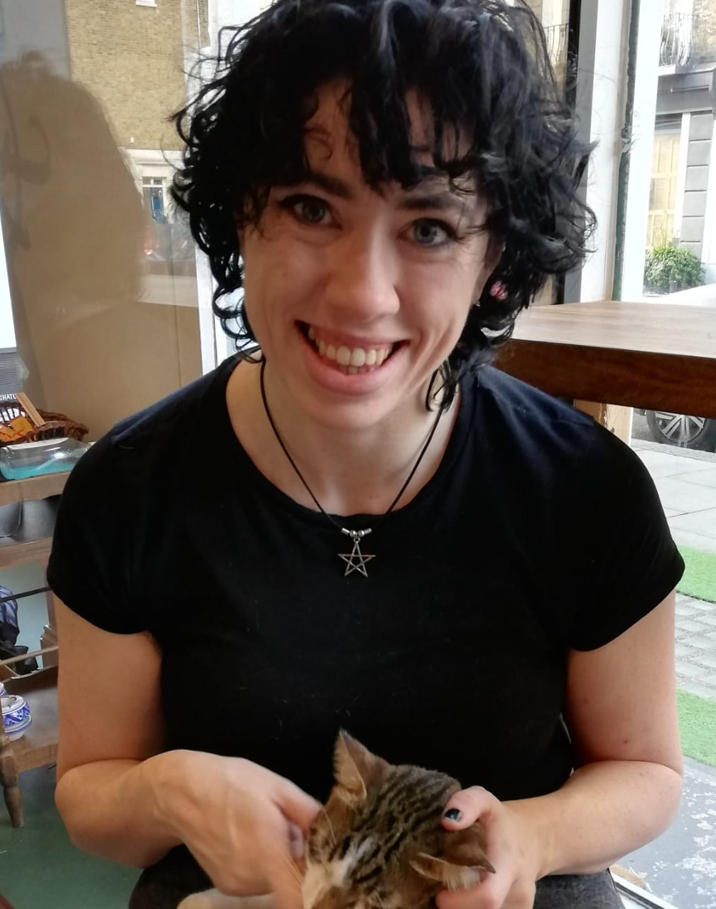
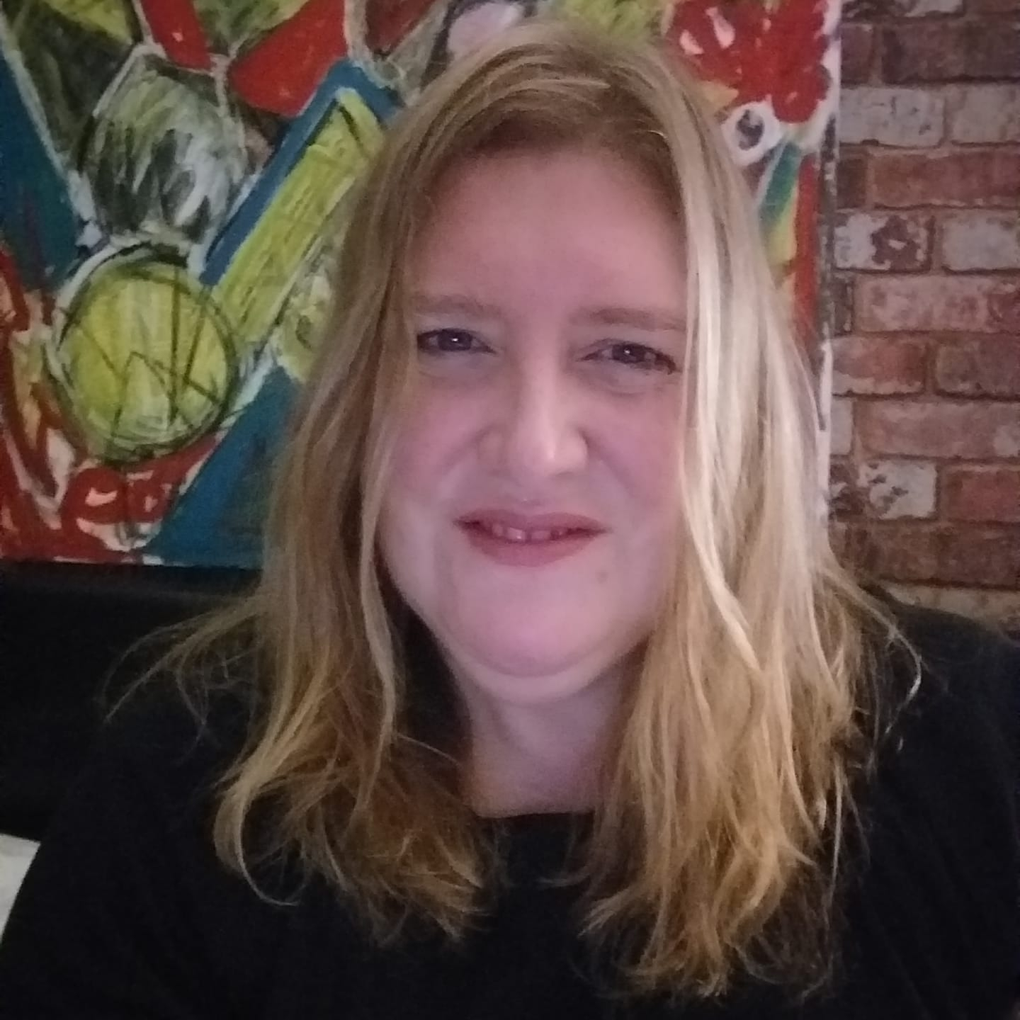
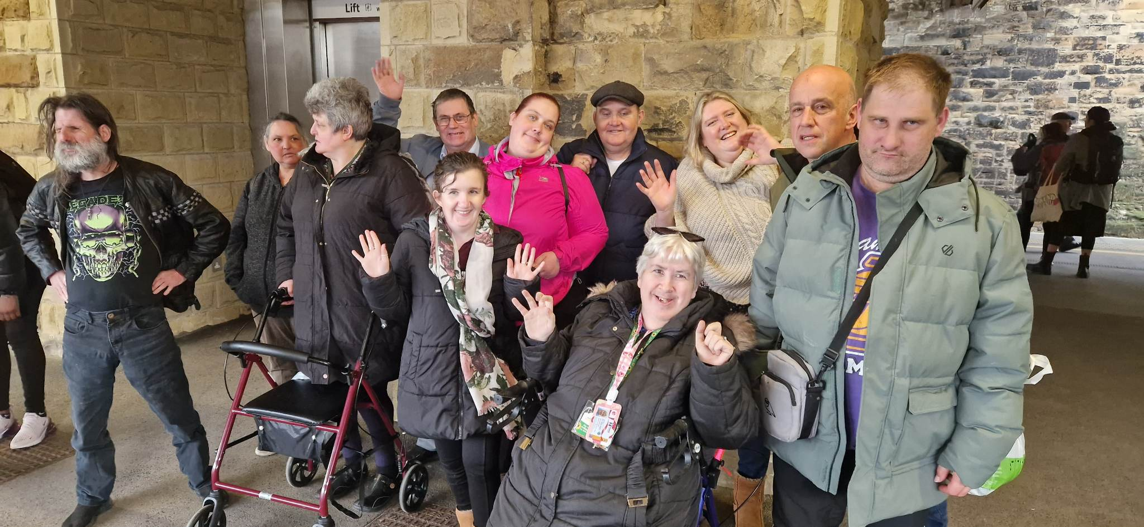
Our staff!
Kelly
Kathryn
Volunteers
Andrew, Elena, Cathy and Gill
Ambassadors
?

Slide 4
Tuesday
Easy read group 9.30- 10.30 Self Advocacy Meeting 10.45-12pm
Wednesday
The Big Voice Drama Group 2-4pm
Social night 7-8pm
Thursday
In person self-advocacy meet10-12pm
LGBTQ+ Inclusive Cafe 3-5pm
Friday
Magic Pen online writing group 2-3pm
The 'Art of voice' art group 2-4pm
Our day to day business

Slide 5
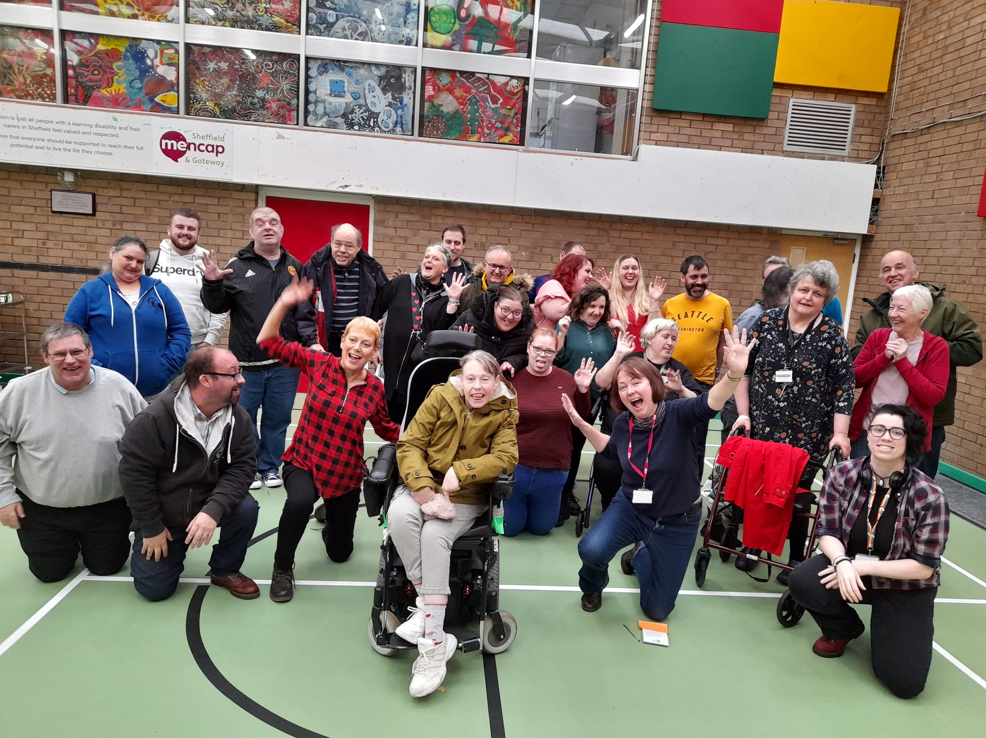
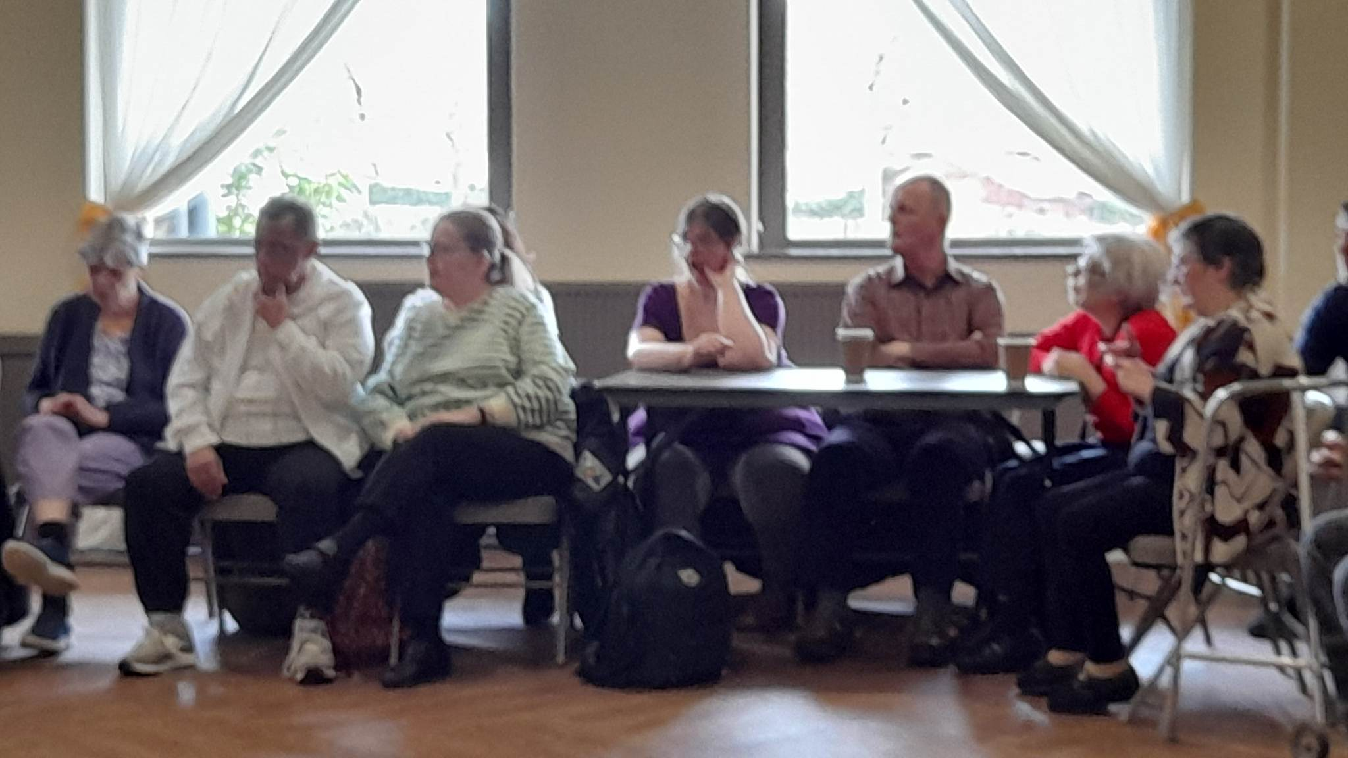
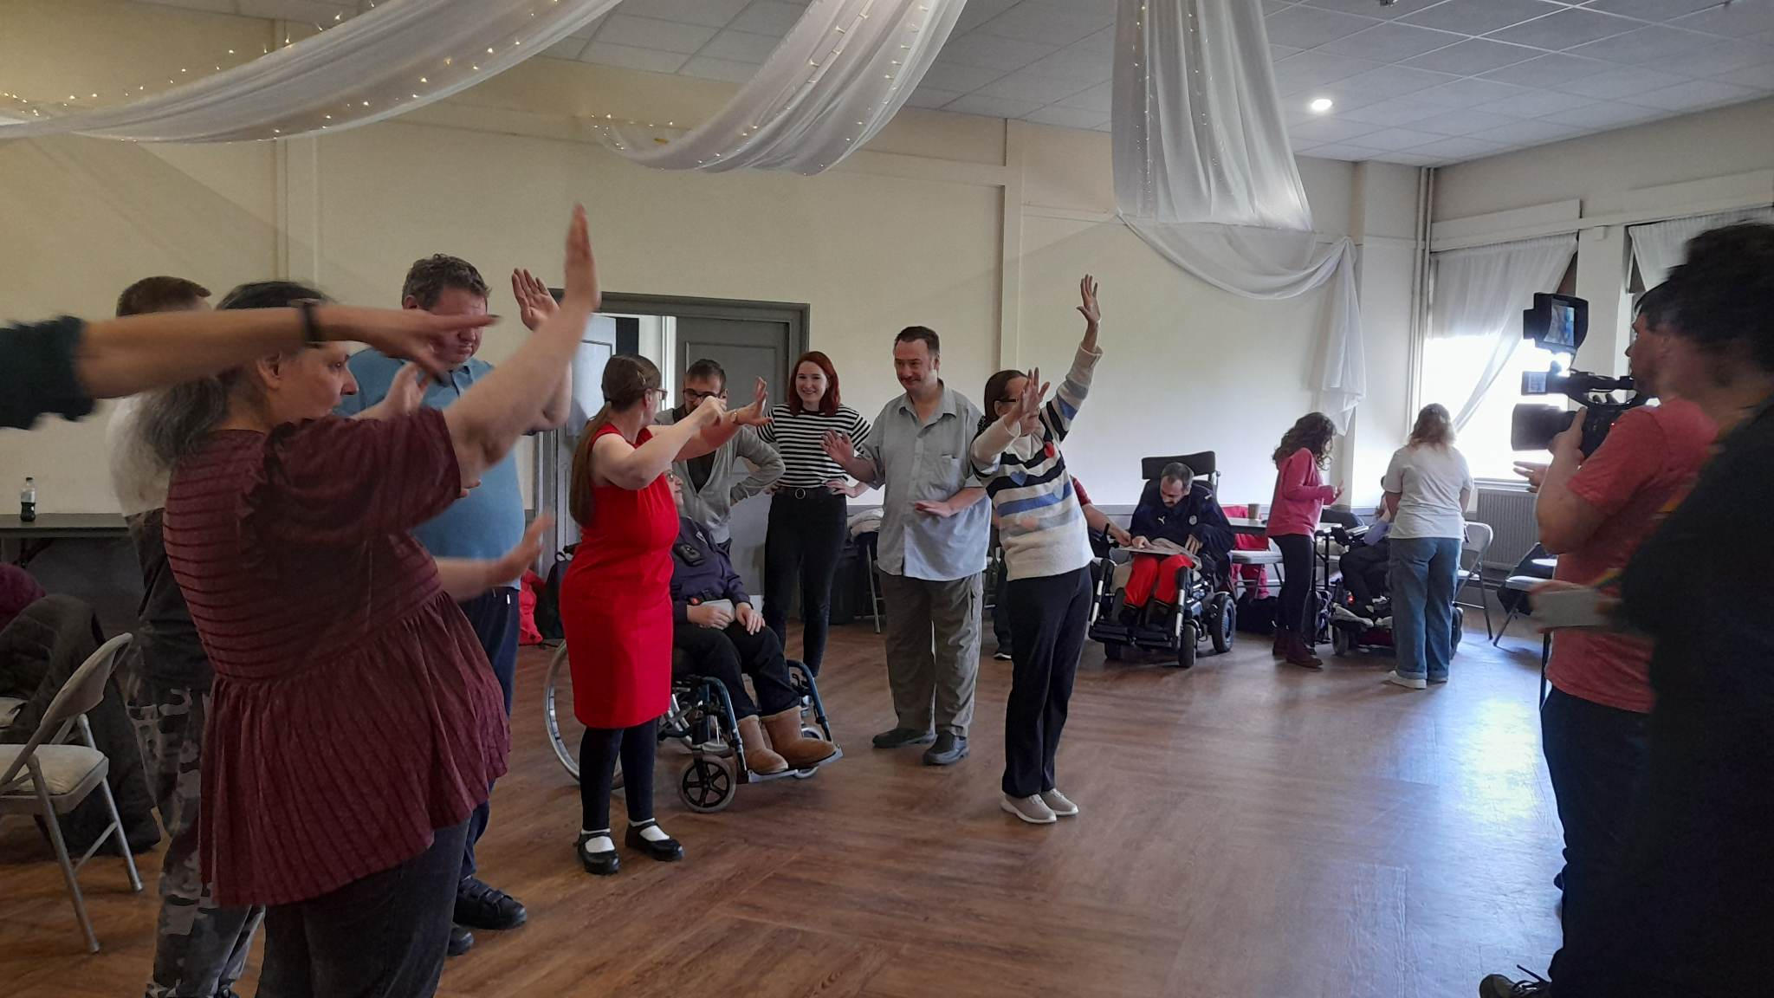
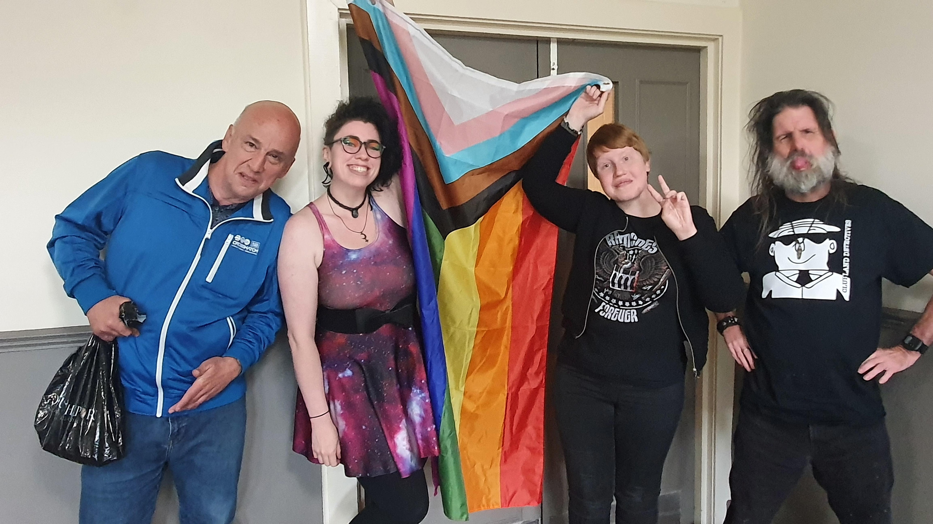
What is We Speak You Listen?

Slide 6
Sheffield Voices Core Group
Earned monies
Commissioned Services
Peer projects
Grant Funded Projects
Easy Read
Firshill
Enactus
SCC Strategy
Films
SHSC Strategy
MSE
Mate Crime
Art Group
Ambassador earnings
Climate Change
What About Me?
WSYL
Cohesive Communities
Training
Collaborative Conversations
Big Voice Conference
Humanising Healthcare

Slide 7
Why are
we needed?
Connection
Empowerment
Enablement
Good lives
Speaking up
Confidence
Peer Support

